Slide 1
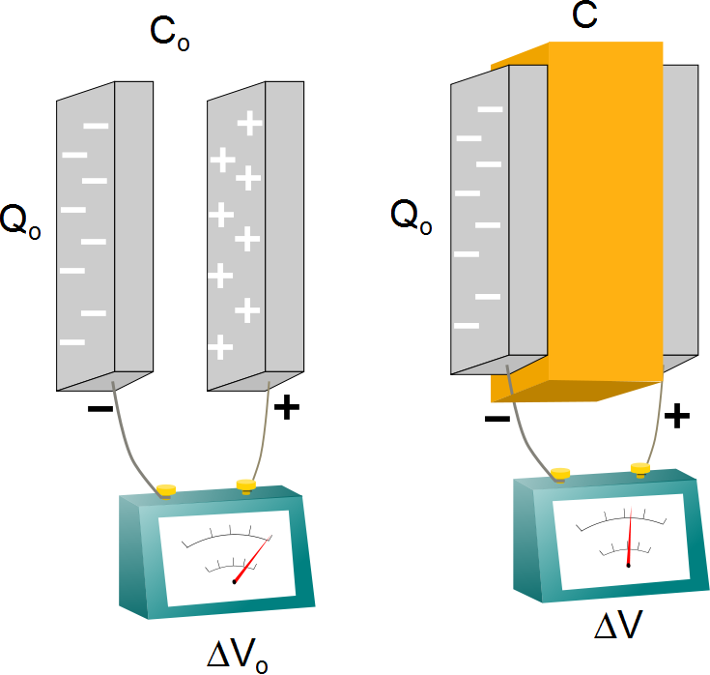

Slide 2
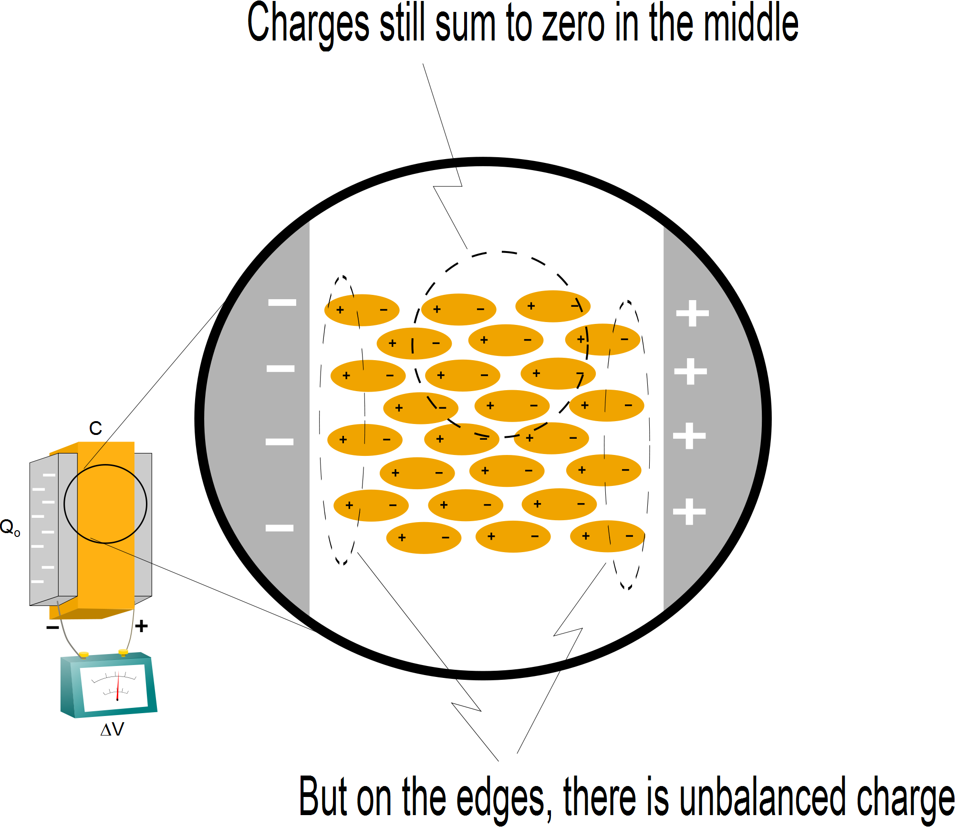

Slide 4
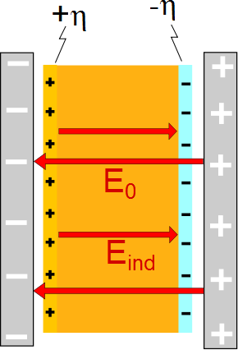

Slide 5
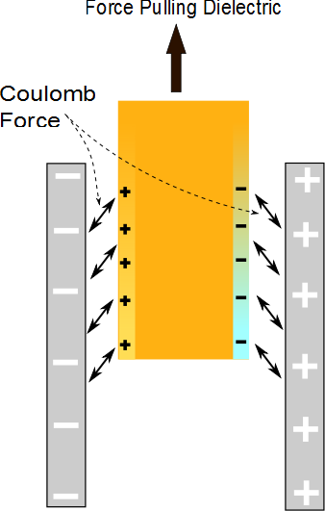

Slide 7
Δ
Δ
x
x
q
q
v
v
d
d
A
A

Slide 9
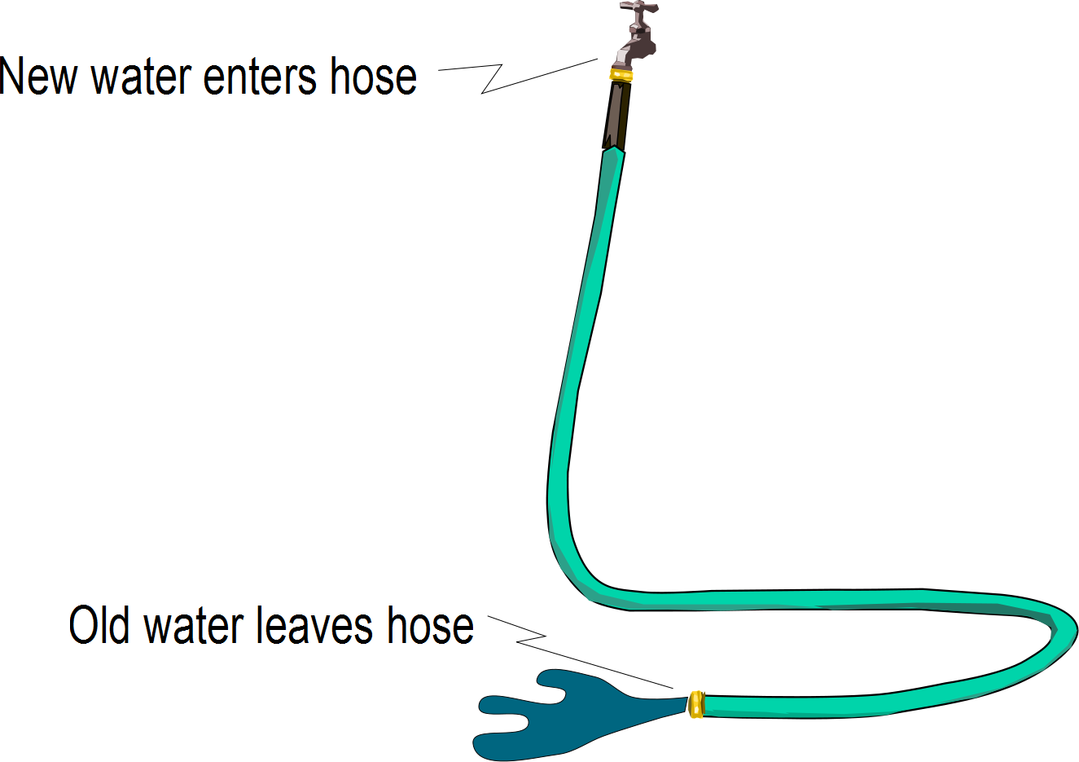

Slide 10
a

Slide 11
